Slide 1
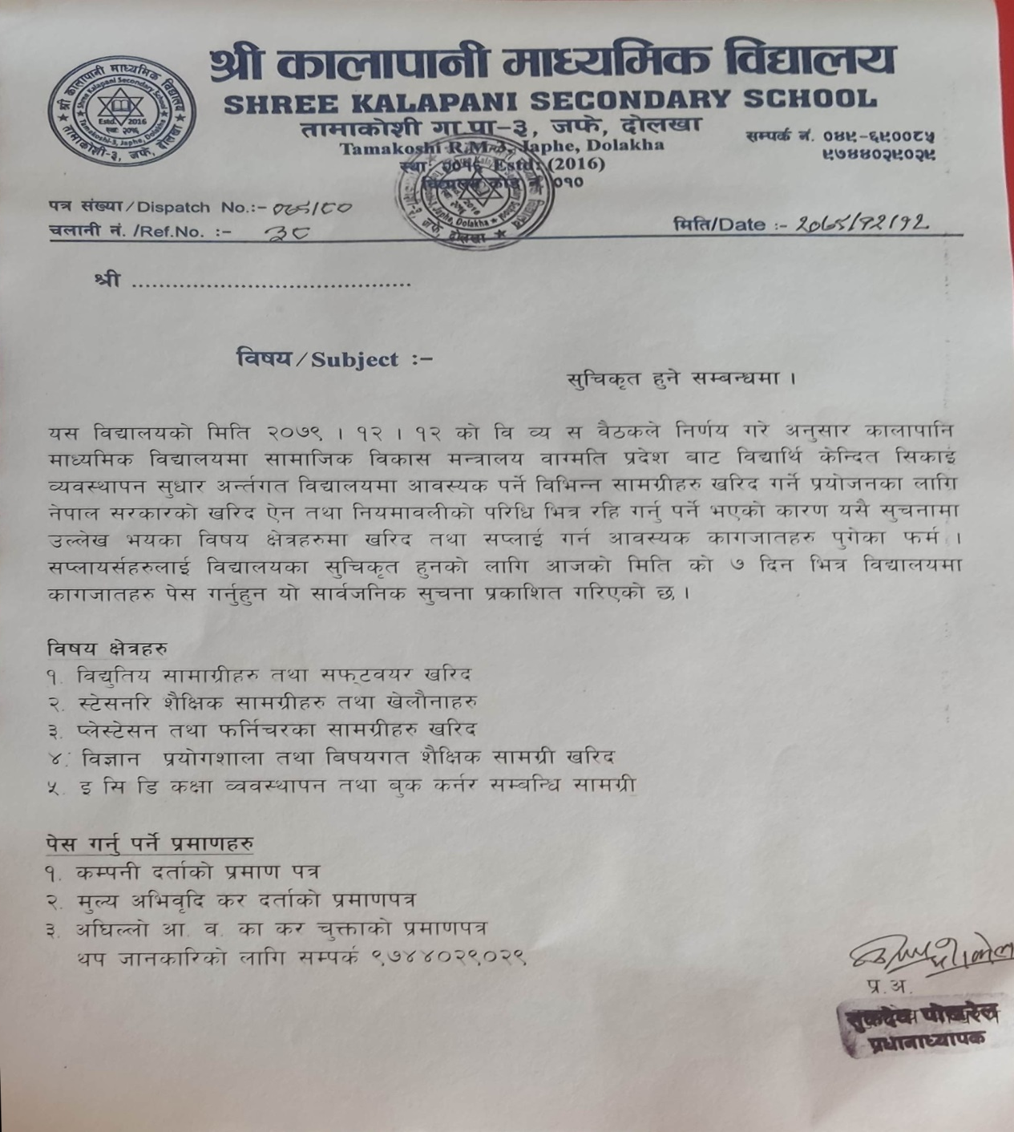
>L sfnfkfgL dfWoflds ljBfnosf] ljBfly{ s]lGbt Joj:yfkg ;'wf/ sfo{qmdsf] cg'bfgsf nflu ;'lrs[t ;DjlGw ;'rgff

